Slide 1
Week 08 Debugging & Deployment

Slide 2
Agenda:
Q&A
Approaches to debugging
Deployment
Team Scrums
Next week: internal test plans doc & presentation, lecture: metrics, team scrums
Two weeks to next demo!
Five weeks to final demo!

Slide 3
Debugging Approaches

Slide 4
Don't Write Clever Code
"Everyone knows that debugging is twice as hard as writing a program in the first place. So if you're as clever as you can be when you write it, how will you ever debug it?" - Brian Kernighan
Keep It Simple Stupid
The next person to work on this code may not be as smart as you
Build something that anyone can understand, maintain and deploy
Future You will thank Present You

Slide 5
Small, Simple Methods
Keep your code readable and document assumptions
Use long, descriptive naming for your methods
Others can't debug what they can't understand
Long methods are much more difficult to debug, especially if there are many code paths to trace through
Breaking methods down means a greater chance of reusing a portion of the code later

Slide 6
Defensive Coding
Especially if you are writing something that can be reused
Validate whatever you can before you do any processing
Often a good exception to the “return from only one place” rule
void DoSomething(Thing thing1, Thing thing2)
{
if (thing1 == null) throw new ArgumentNullException (“thing1”);
if (thing2 == null) throw new ArgumentNullException (“thing2”);
…
}

Slide 7
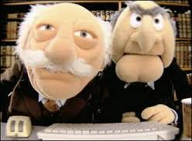
Pair Programming/Code Reviews
Given enough eyeballs, all bugs are shallow
– Eric S. Raymond (Linus' Law)
Everyone has blind spots
Egoless programming – it's the companies' code, not yours
People will leave your company (maybe you!)

Slide 8
Check anything out of your code's control – ASSUME NOTHING!
Ensure that your I/O worked
Check memory allocations (where applicable)
Networks, database connections, printers, hardware can all become unavailable at any time
Other people's methods can cause bugs in your code, too!

Slide 9
Don't Optimize (yet)
Programmers waste enormous amounts of time thinking about, or worrying about, the speed of noncritical parts of their programs, and these attempts at efficiency actually have a strong negative impact when debugging and maintenance are considered. We should forget about small efficiencies, say about 97% of the time: premature optimization is the root of all evil. Yet we should not pass up our opportunities in that critical 3%. (Donald Knuth)
Make it right, then make it fast
Better algorithms make more difference than “tricky” enhancements
Measure and make sure that you are optimizing the right things

Slide 10
Don't (rarely) swallow exceptions without action
Exceptions mean that something … exceptional happened; shouldn't you do SOMETHING about it?
If something failed, should your program proceed? If so, how?
Corollary – Don't throw exceptions unless necessary
If you need to swallow exceptions, comment it!
try
{
result = numerator / denominator;
}
catch (DivideByZero e) {} // Do nothing because the old result is right

Slide 11
Write Unit Tests
They give you confidence that existing code hasn't broken your new code
They allow you to change code freely knowing that bugs will be easily visible
Test only what can fail – simple assignments, for example, are a waste of time and give the impression of test coverage without the reality

Slide 12
Keep Your Code Readable
If you can't read it, you can't fix it
If I can't read it, I can't fix it!
Code becomes unreadable over time and changes – refactor mercilessly
Document assumptions (outside APIs, parameters, etc.)

Slide 13

Don't Ignore Compiler Warnings
“It's only a warning...”
Use other tools as appropriate for your language/IDE (Lint, etc.)
Let the compiler help you – avoid cases where the compiler can't (dynamic, generated SQL, manually generated code)

Slide 14

Don't Copy/Pasta
The only thing worse than 1 bug is 2. Or 3 or 10...
You can fix a bug in one place and not another
Prevents “unfixable” bugs
Keeps your code base small and reusable

Slide 15
Don't Write a Lot of Code without Testing – Test Driven Development
It's easier to find the bugs in a smaller piece of code than in a larger one
You can forget to test corner cases
Less mental model to forget when someone interrupts you

Slide 16
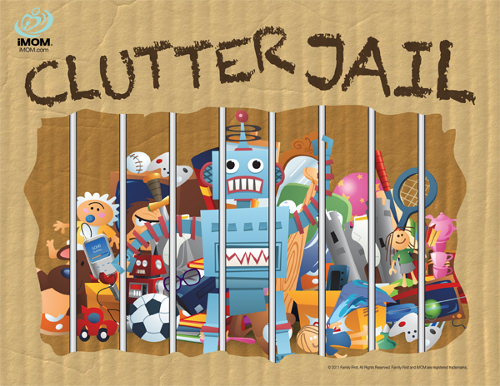
Put away your toys when you are done with them
If you allocated it, free it
If you opened it, close it
If you connected, disconnect
If you locked it, unlock it
Why am I getting this deadlock?
Why is this file locked?
Where is this timeout coming from?

Slide 17
Avoid Global State
This includes read/write: Session, static classes, Singletons, “God objects”, etc.
Break your methods down
Pass in or inject dependencies
“What set this to null?”

Slide 18
Understand What You're Working On!
You CANNOT develop what you don't understand!
You CANNOT tell what is broken if you do not know what the system is supposed to do
You CANNOT change something that doesn't make sense to you
Well, you CAN, but you can't do it well...

Slide 19
Assume Nothing!
Assumptions can cost you hours. Look for proof.
But... Try what seems obvious first, if you know the system well.
Don't assume that the compiler and
the framework are perfect, but their
code is probably better tested than
yours...

Slide 20
Get a Reproducible Test Case
If customer/QA doesn't give you one, make it yourself. Torture the code into giving up its secret.
Try it on your machine. Then on theirs. Then launched from their tool bar, then using their mouse until you find it.
Create a test that reproduces the bug, then fix it

Slide 21
Regressions
If this is a new bug, look in the previous version to see what changed – it can give you clues.
Write a test to make sure that this can never happen again.
Don't believe the lie - “I learned my lesson...”

Slide 22
Report Only What You Can Prove:
Know the Root Cause
Too often bug reports GUESS at what is happening behind the scenes
We need facts, not guesses – guesses can color perceptions of those who fix the bug (even you!)
“The label is wrong” is better than “the label has an out of date value”, unless you can PROVE that the value is out of date...

Slide 23

Permanent Logging
Levels and “chattiness” depends on your system needs
Can help immensely with debugging (it got THERE?)
Can also be useful for other things (How much is this functionality used? How long does this take?)

Slide 24

Temporary Logging
Shows execution/timing
through a code path.
Tracks key variables.
Can be removed when the bug is fixed.

Slide 25

Dump Exceptions Recursively
The most useful portion
of any exception will be
the inner exception that
didn't get written to the
log file!

Slide 26
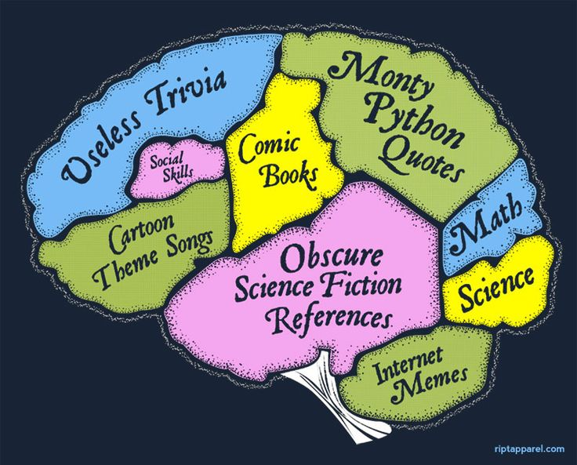
Take a Break And Do Something Else
Go for a walk, get a
drink, hold a meeting.
Let your subconscious
chew on the problem.
Debugging is hard work.

Slide 27

Use The Debugger!
Conditional Breakpoints
Step through and inspect
Watch for – optimization, native debuggers,
timing, race conditions and obscure cases.

Slide 28
Divide and Conquer
If there are 10 steps to a process, see what is happening at step #5
Breakpoints can help with this
…or print statements.

Slide 29

Run Snippets of Code Elsewhere
Sometimes it is hard to get to the part of a program where you want to reproduce some issue.
Grab the relevant code and mock something up in LinqPad or make a Console Application!

Slide 30

Focus On One Bug At A Time
If you come across something else, make a note.
Side effects are easy to introduce, especially in unclean code bases.
If you try to fix it and fail, rollback your changes and try again. Don't “shotgun it”

Slide 31
Consider the bigger picture
If I forgot to HTML encode this, did I forget it elsewhere? Maybe it’s time for a reusable piece of code?
Could my change break something else?
Maybe it’s time for a local Band-Aid…
Is this a systemic problem?

Slide 32
Document what changed and why
Document in the bug tracker (you do have one…)
Document in source control
Document in the release notes
DO NOT DOCUMENT IN THE CODE
Unless it deserves it

Slide 33
Ensure that it doesn’t recur
See bad patterns
Learn more about our craft
Unit Tests
Coding Standards
Tools

Slide 34
Deployment

Slide 35
Design for deployment & operation
Deployment for non-trivial systems is often complicated
Where rubber meets road – lots of potential interactions
With OS
With other production systems
With other / operational teams
Treat deployment like another technical problem needing design, implementation, test
Rehearse the release process in a "staging" environment which ~clones production
Treat operations like another group of users needing requirements, design, maybe tools
Include at least considering this design early in the process

Slide 36
Deployment Planning
Who does what & when
Pre-release steps & checks
Day-of steps
Determining viable / reduced risk time for deployment based on company & customer schedules, other factors
Go/no-go decision based on (hopefully) standard QC checks
Communicate with users: in advance, after "go", after complete
What if things go wrong during execution? – need a rollback plan
Is one even possible? Practical? Necessary?
Are there any "fail safe" points in the process, beyond which a rollback is not possible?
Will we have to "fail forward"?

Slide 37
Deployment schemes (for hosted apps, depending on the system architecture)
Big bang – system goes down, release happens, system comes back
Rolling update – system stays up during the release as components are cut over incrementally
e.g. load balancer routes new users to the new system nodes (e.g. new Web nodes) while existing logged in users continue to use old nodes
Eventually users log out / are thrown out and all sessions are on the new nodes
Gradual user or component cutover
Select users move to the new system / new component
When deemed stable, more users move until all completed (e.g. beta release of app)
e.g. parallel systems – old system & new system stay running together, until we're sure new one is stable

Slide 38
Deployment tasks
Physical environment – e.g. prepping new servers
Documentation – updating operational & user docs
Training – see above
Database – schema change is notoriously difficult to rollback!
Data – updating control data, migrating old user data to new schema
Application software – deploying our new code
3rd party software, OS patches, etc.
Other – often lots of onesy-twosy stuff

Slide 39
Deployment Rhythm
Avoid long lulls between releases followed by "big bangs"
Prefer small, incremental, frequent updates especially if they are silent / low impact on the user
Customer issues get fixed rapidly
Change is managed in smaller pieces
Aligns with agile methodology
Reduce scope of risk
Plan major releases well in advance, infrequently
e.g. customer-facing impacts, impacts on new versions of APIs, breaking change, etc.

Slide 40
Deployment tooling – building ("CI")
Have a build system – be able to build repeatably without fear of manual mistakes
Jenkins or home-grown tools - monitor change to source & build when needed
Prefer to deploy to production exactly what was tested
Avoid needing a separate build for production – deploy what was build for "stage"
Prefer tools to automatically build after each check-in of code
Immediately catch breaking changes – shame the culprit who "broke the build"!
Build places artifacts in some holding pen awaiting deployment

Slide 41
Deployment tooling – deployment ("CD")
Take artifacts from the holding pen & install them on the target nodes
Deployment tools come in many forms, OS dependencies
Chef, Puppet, Ansible, AWS Elastic Beanstalk, Docker, home grown, etc.
Notate what was deployed where (i.e. configuration management)
Code check-in --> CI tool builds --> CD tool deploys --> "CQ" tool verifies
AUTOMATICALLY
CQ e.g. "run the priority regression test cases after each deployment", i.e. "smoke test"

Slide 42
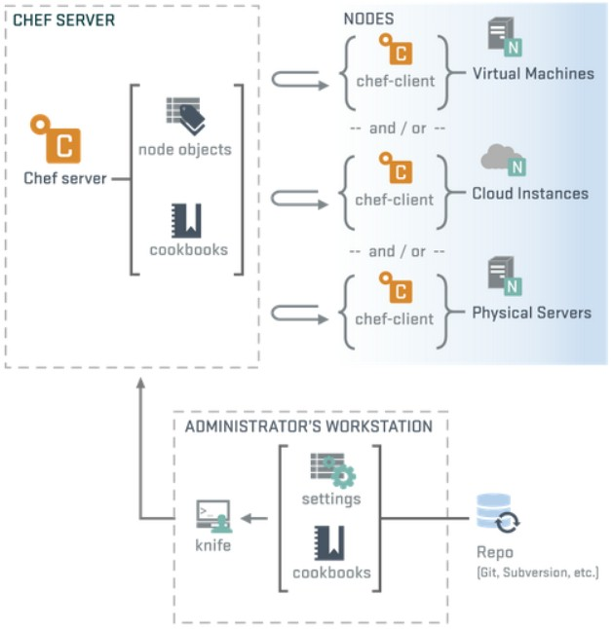
Chef: Infrastructure as code = Virtualization

Slide 43
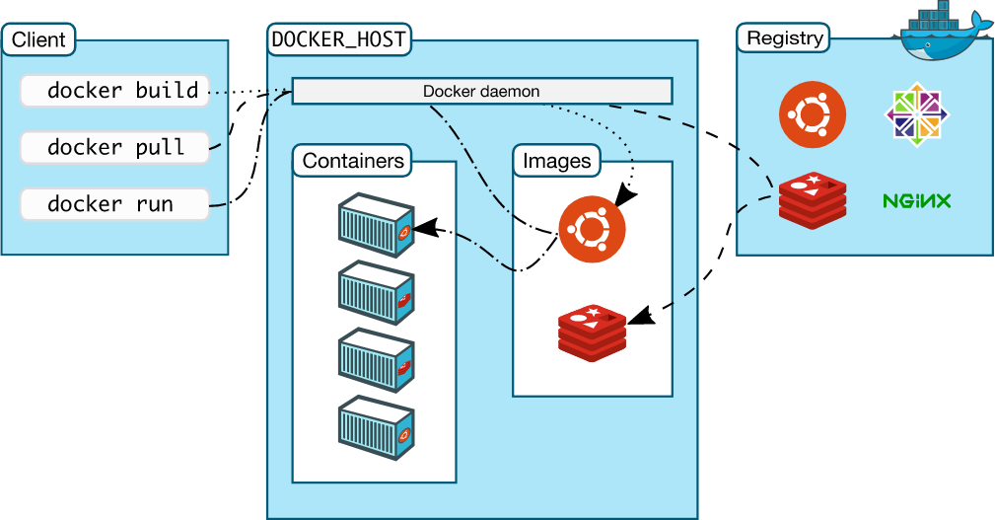
Docker: Virtualization via Containerization

Slide 44
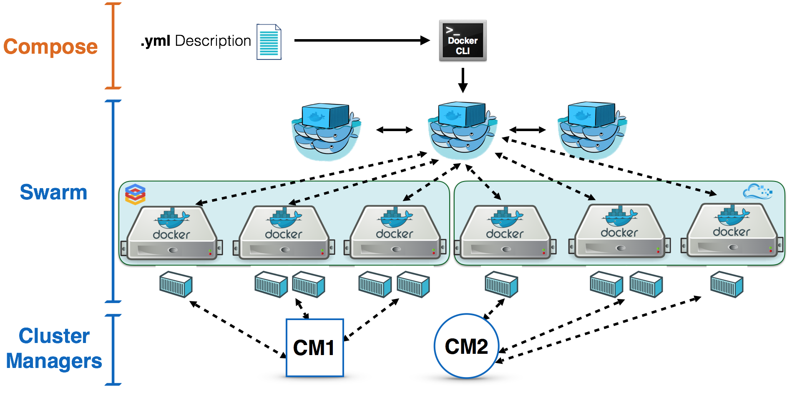
Docker Swarm

